Slide 1
Oracle Reports-New Development & Modifications

Slide 2
What to Expect from the session
After the session there will be clear understanding of below mentioned topics
Understanding report specification - MD50 walkthrough
Develop report from the MD50
Develop New Reports - Simple & Medium - (RDF + BI Publisher)
Modify Standard Oracle E-BS Reports
Debugging Methods
Report Scheduling & Debugging
Code Packaging & Deployment
Walkthrough of MD070(Technical Design) and MD120(Deployment Steps)

Slide 3
Topics
Report Building
Data Model
User Parameter
Queries
Groups
Formula Columns
Placeholder Columns
Data Links
Report Triggers

Slide 4
Topics
Program Units
Lexical Parameters

Slide 5
Report Building
Reports can be develop through RDF and BI Publisher
Some Points Regarding Reports are:-
Debugging Methods
Report Scheduling & Debugging
Code Packaging & Deployment

Slide 6
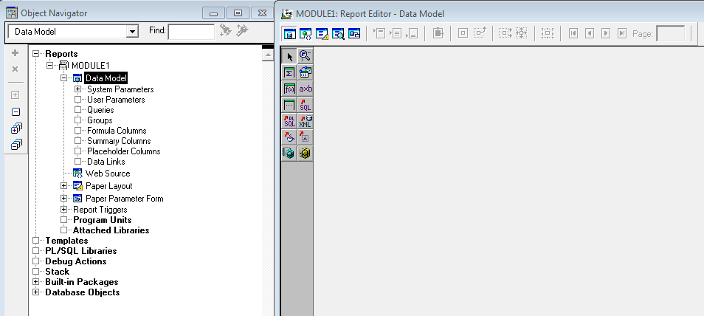
Data Model

Slide 7
User Parameter
There are two ways to create user parameters
Explicitly
Mention directly in Query
(These two ways apply for Lexical parameters as well)
They are mainly used in connecting the parameters passed from the concurrent program to the RDF (Front end – Back end)
Scope remains throughout RDF
Use : to access a user parameter (which always start with P_) eg → :P_ITEM_NAME
Exercise → Create a user param Organization_Id which will come from Concurrent program

Slide 8
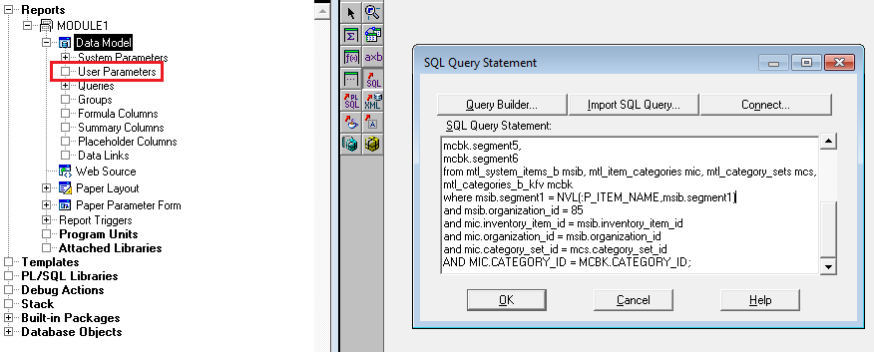
User Parameter

Slide 9
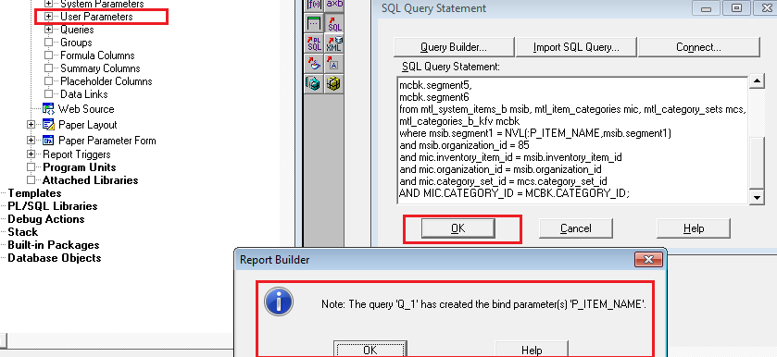
User Parameter

Slide 10
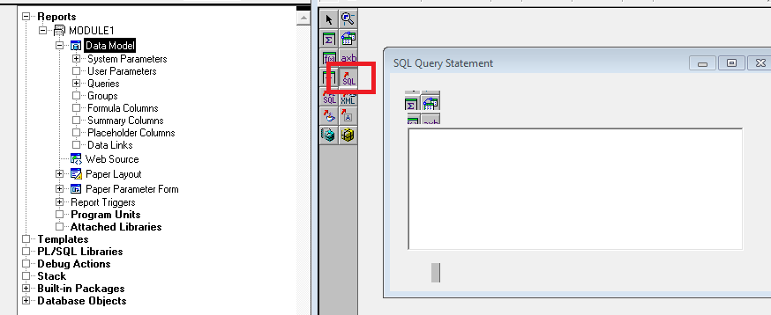
Queries

Slide 11
Groups
A group is created automatically when SQL query is written
All the columns selected form the items of that Group
There is an up arrow mark against all those columns which are fetched from the query
You can introduce placeholder, formula, summary column inside any Group(These will not have the arrow mark)

Slide 12
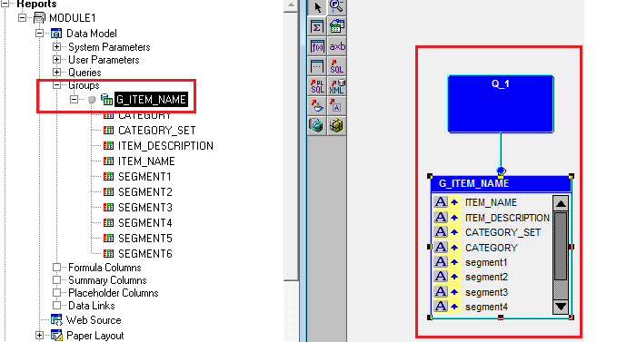
Groups
This how a group looks like

Slide 13
Function/Formula Columns
Known as function as well formula columns
As the name says, these columns also store value but in form of a return value
They will have a Function created for them which have a return value
This will be the value of this column whenever it is referred in the report
Like Placeholder, they have same scope concept at Group level, report level

Slide 14
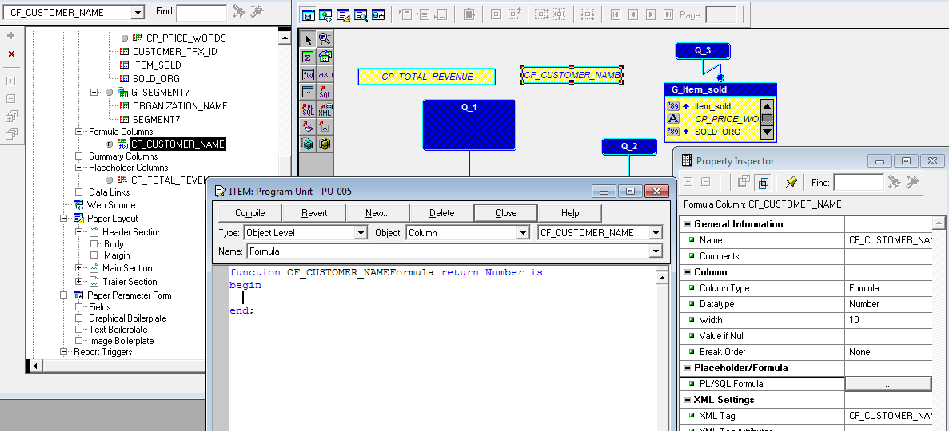
Function/Formula Columns
You cannot write :Cf_Customer_Name :=

Slide 15
Placeholder column
Placeholder columns is simply like a variable
It is used only to store some value which can be referred at specific point in the report
A placeholder defined outside all the groups will have scope on overall report
It can be used anywhere in the report, inside any trigger, any program unit etc
After creating it, its different properties can be set in the property palatte
Here CP_REVENUE_TOTAL is a placeholder defined at report level and CP_PRICE_WORDS is at Group level (G_item_sold)
Anywhere in the report to use this placeholder, you can write :CP_REVENUE_TOTAl := 450

Slide 16
Placeholder column
Here CP_REVENUE_TOTAL is a placeholder defined at report level and CP_PRICE_WORDS is at Group level (G_item_sold)
Anywhere in the report to use this placeholder, you can write :CP_REVENUE_TOTAl := 450

Slide 17
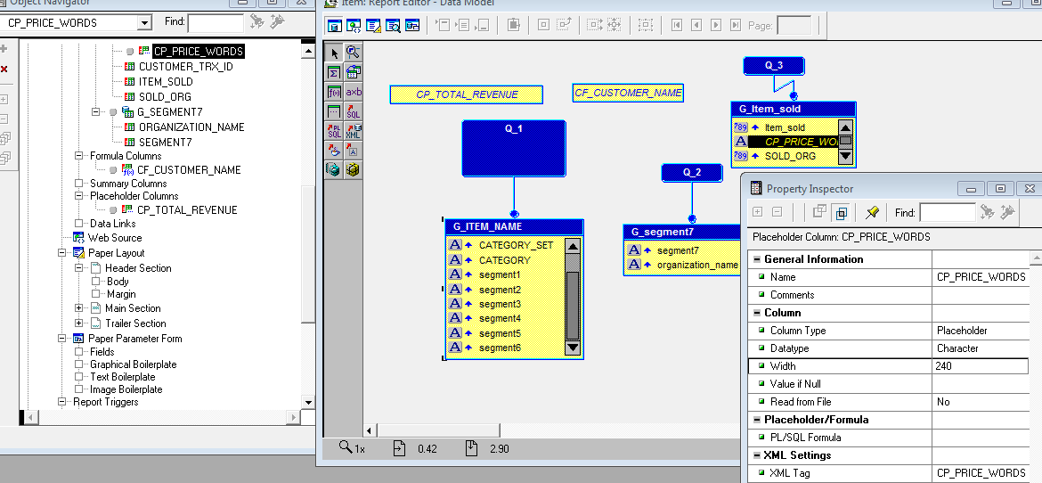
Placeholder column

Slide 18
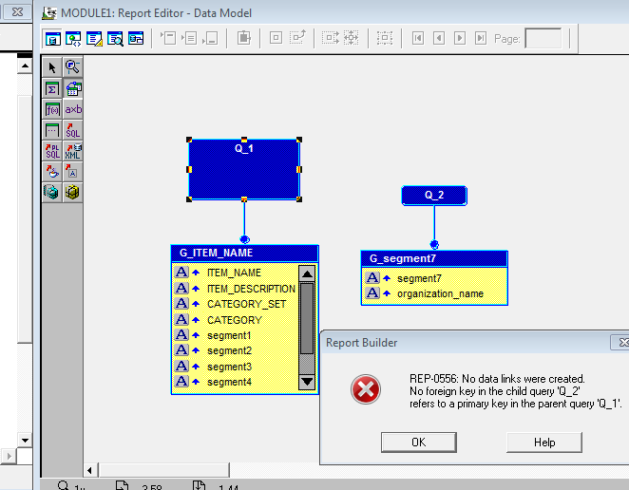
Data Links
Master – Detail Relation
A Data link is used to connect one Query to another query using a reference field from the first (parent) query

Slide 19
Data Links
Here we are trying to create link between Q1 and Q2
Exercise → Create correct data link between Q1 and Q2
(Q1 and Q2 will be shared in classroom training)

Slide 20
Exercise
Exercise → Create Correct Formula column that will retrieve Customer Name from Q3
Q3 will be given in Classroom

Slide 21
Report Triggers
5 Types
Before Parameter form, After parameter Form, Before report, Between Pages, After Report
These are nothing but Pl/SQL functions returning always Boolean
With help of these triggers, you can fetch any database values which will be used in forming Queries (you can store value into a Report level Placeholder column and use it in forming the main query) or you can set MOAC etc

Slide 22
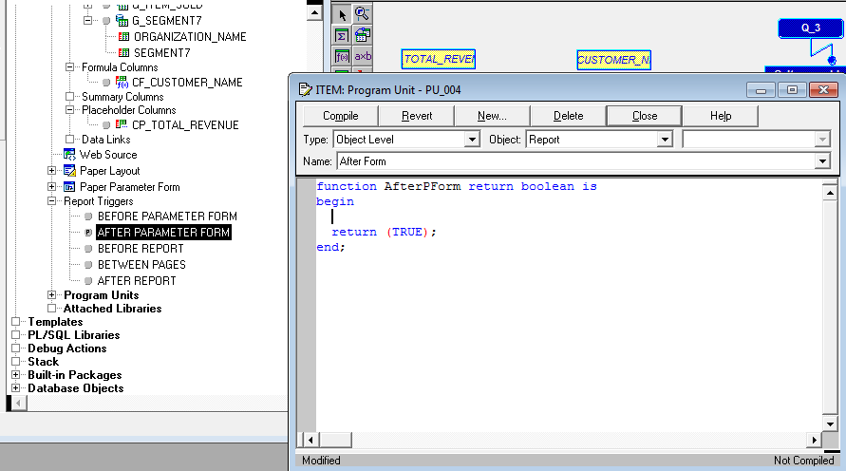
Report Triggers (Cont.)
Exercise → Set MOAC for the passed Operating Unit in the rdf
This will help you to retrieve data in Query Q3, which will be shared in classroom

Slide 23
Program Units
Any Procedure, Function, PKB that you need for your rdf, can be created under program units section
This helps to modularize your report code
These are different than Database objects

Slide 24
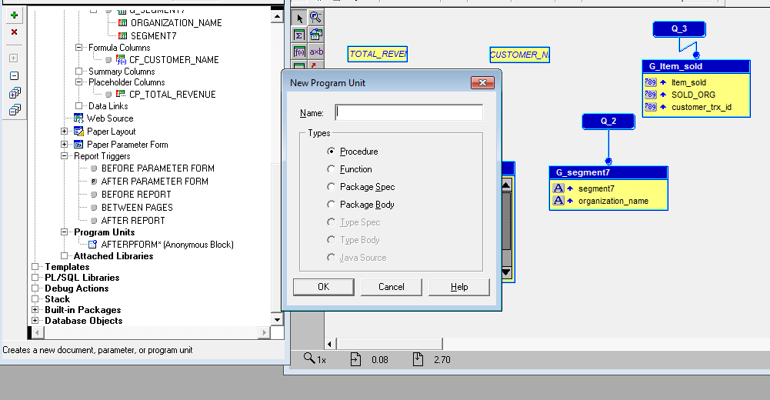
Program Units (Cont.)

Slide 25
Lexical Parameter
A Lexical parameter is actually a user parameter
You cannot call a placeholder or formula column, a lexical parameter
A lexical parameter is used to generate dynamic query
Use & to access LP, eg → &LP_QUERY
You assign value to LP in Before report mainly

Slide 26
Questions and Answers

